Slide 1
Auto-Tagging of Text Using Large Language Models (LLM)
Team Members:
Aleksandr Vashchenko
Grigoriy Nesterov

Slide 2
Contents
Introduction
Problem Statement
Methodology
Experiment and Results
Conclusion

Slide 3
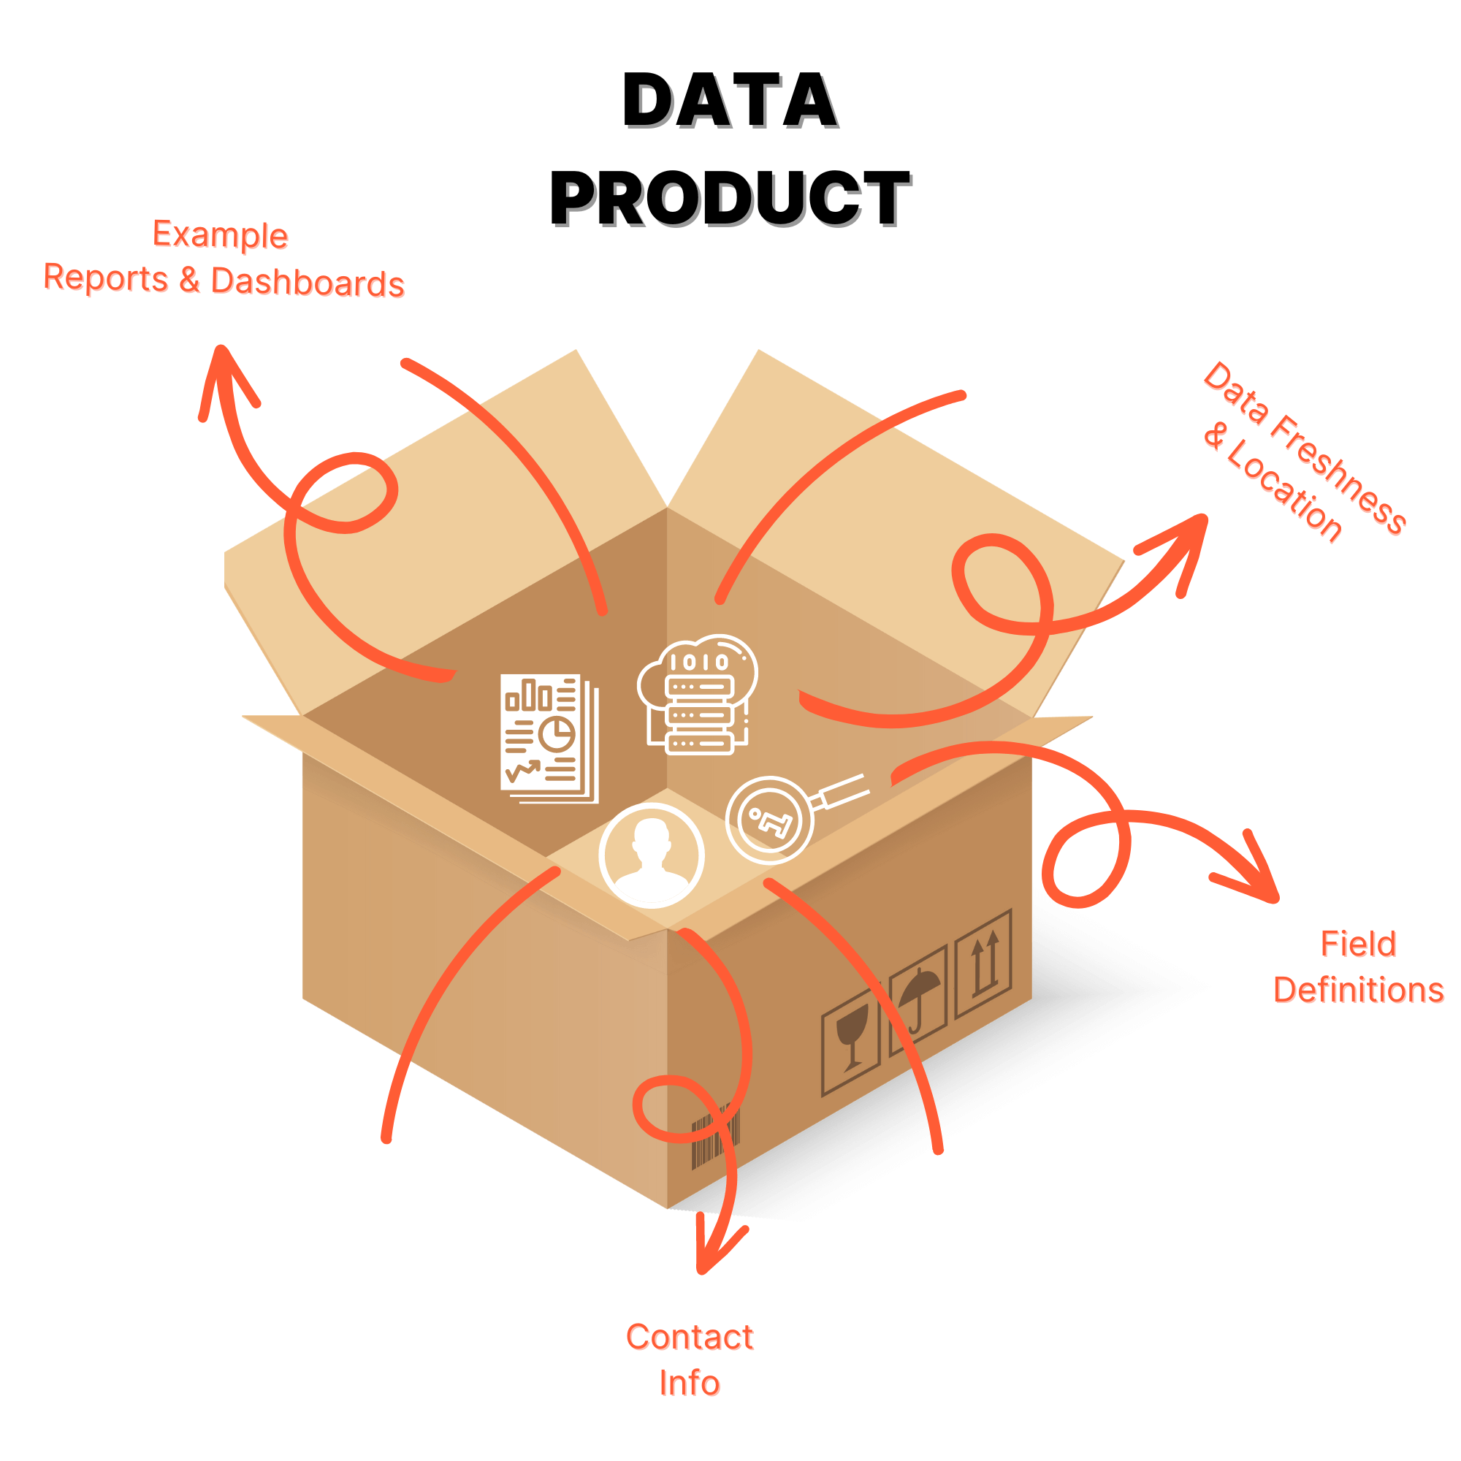
Introduction
This project is part of a project to implement a dataset tab (similar to kaggle), in this project we are implementing a tag matching recommendation system. When a user creates a new dataset and fills in tags to it, they can be generated based on the description and other information filled in for the dataset earlier.

Slide 4
Problem Statement
Kaggle offers a repository of over 516 tags organized into 6 groups for dataset categorization. The sheer number of available tags makes it challenging for users to manually select the most appropriate tags for their datasets. This often results in the selection of irrelevant or suboptimal tags, which affects the overall quality of the tagging process.
People don't want to have to search for the right tags.
Improperly tagged datasets become difficult to locate through search functions

Slide 5

Methodology
Data collection.
Data preprocessing.
Model Selection and Training.
Model Evaluation.

Slide 6
Methodology - Data Preparation
Data collection - We parsed 4,000 metadata from the kaggle by 561 labels - tags.
Data preprocessing - Features which we leave: dataset name, under dataset name, dataset description, tag list. The first three are used as features, the last list as a label. We translate tags from English to Russian. We concatenate the features, process them with the tokenizer of the BERT or concatenate input data with our prompt to saiga LLaMa.

Slide 7

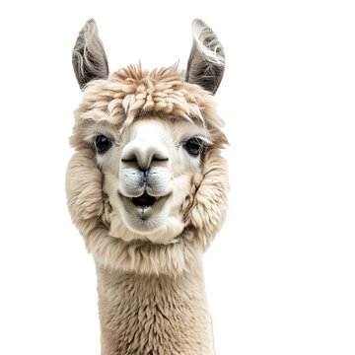
Methodology - Model Selection
We picked a BERTModel from transformers and saiga LLaMa 8b and fine-tuned them.

Slide 8
Experiments
We fine-tuned our chosen models and compare it:
For BERT we check some number of labels, architectures of model after BERT layer, number of epochs, loss function, some hyperparameters.
For saiga LLaMa 8b we check optimizer, lora, prompt types, instruction of prompt, outlines, some hyperparameters.

Slide 9
BERT - experiments
Parameter | Value
Architecture | BERT, dropout, linear layer, linear layer, relu
Dropout coefficient | 0.3
Loss function | Asymmetric for Multi-label Classification
First linear layer dim | 1024 to 2048
Second linear layer dim | 2048 to 516
Maximum tokens | 512

Slide 10
Saiga LLaMA 3 8b - experiments
Parameter | Value
Prompt | Zero-Shot Learning
LORA | with alpha 32
Dropout coefficient | 0.1
train_batch_size | 1
eval_batch_size | 8
seed | 42
Parameter | Value
Learning rate | 3e-4
Optimizer | AdamW
Epsilon | 1e-8
Betas | (0.9, 0.999)
Temperature | 0.5
seed | 42

Slide 11
Results of experiments
The analysis of the experiments demonstrated that LLaMa, with the optimal configuration, outperformed BERT in terms of accuracy and relevance of generated tags. The use of structured contours for label classes did not show positive results, so it was decided not to use it in the final solution. LLaMa’s superior performance can be attributed to its advanced model architecture and the parameters of fine-tuning, which improved its ability to handle complex language patterns and multi-label classification tasks in current domain.

Slide 12
Conclusion
The experiments showed that LLaMa, with optimized fine-tuning and prompting, outperformed BERT in generating accurate and contextually relevant tags. LLaMa's advanced understanding of complex language patterns, prompting, fine-tuning and structured information provided a significant advantage in multi-label classification tasks, resulting in superior tagging performance.

